Slide 1
Selected Topics on IoT Networking
Low-Power Operation

Slide 2
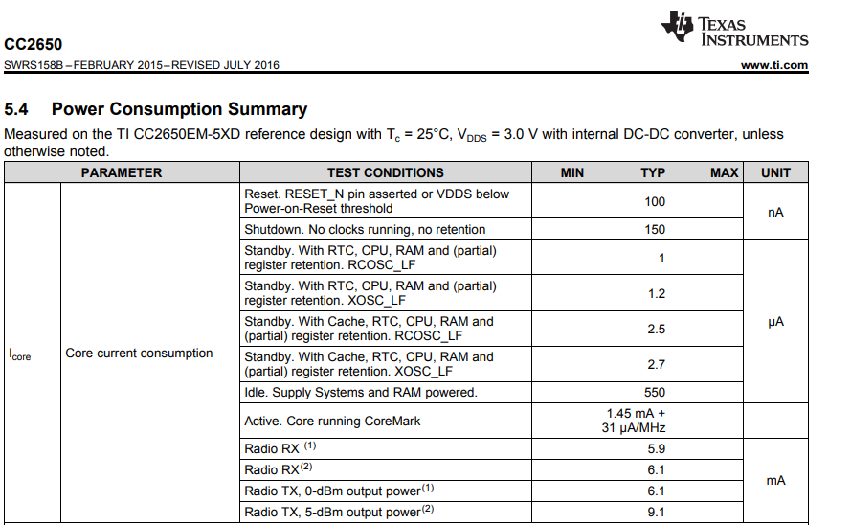
Low-Energy Operation
x1000

Slide 3
Radio Duty-Cycling
IoT Devices save energy by sleeping (turning off their radio and cpu)
E.g. 10% radio duty cycle == radio is activated 10% of the time
The challenge
For two devices to communicate, they both need to be awake at the same time
Question: How do they coordinate?

Slide 4
Answer: Asynchronous
Sender-Initiated
Sender transmits packets repeatedly until receiver responds back
Receiver periodically wakes up to check for incoming packets
Receiver-Initiated
Receiver transmits beacons periodically to signal its availability
Sender listens for beacons and transmits the packet after them
Energy wasted for additional radio usage (overhead)
Idle listening, unreceived transmissions

Slide 5
Different answer: Synchronous
Schedule rendezvous points when both sender and receiver wake up
Requires Time Synchronisation
Some level of de-synchronisation can be addressed with a guard time
Yet, guard time increases the radio duty-cycle (idle listening)
Wake-up Point
Rendezvous point
Sleep Point
How do IoT devices measure time?
Guard Time

Slide 6
Time Synchronisation
IoT Devices measure time using some h/w clock source
Hardware clocks fed by oscillators. Typically crystal or RC
Generates an electrical signal at a (hopefully) precise frequency
A typical frequency is 32768 Hz
Challenge: Oscillators can be somewhat inaccurate
As a result, h/w clock sources will drift apart
Drift is measured in ppm (parts per million)
1 ppm drift means a de-synch of:
1usec / 1sec or
1 ms every 1000 sec (16.6 minutes!)

Slide 7
Time Synchronisation
Sources of clock drift
Production spread (+/- 20 ppm)
Temperature difference (40 ppm @ 30 degrees difference)
Measurement error (e.g. quantisation error)
Quantization error example:
With a 32768 Hz crystal, each pulse is ~30.51 usec
327 ticks: ~9979 usec
328 ticks: ~10009 usec
Impossible to measure 10ms precisely!
What’s even worse: Two theoretically identical oscillators may behave somewhat differently

